Slide 1
Optimization of Garbage Container Network
Corné Heijnen

Slide 2
Content
Introduction
Garbage containers + goal
Problem definition
Problem parameters, solution space, bounds
Optimization problems + score function
Methodology
Data Exploration
Data Flow + Architecture
Optimization approximation algorithms & heuristics
Results
Interactive Map of garbage containers
Optimization attempts
Future works
Optimization algorithms
Heuristics

Slide 3
Introduction
Poor recycling percentages in the City of Amsterdam
Centralized clusters of garbage containers of 5 different fractions
(rest, plastic, paper, glass and textile)
Recycling behaviour can be hindered by long walking distances to containers and full containers
Optimization of network of garbage containers
Minimisation of walking distances
Not too many households connected to the same containers
Placement of new clusters or containers not allowed
(Amount of containers per fraction stays the same)

Slide 4
Problem Definition
Some numbers:
14392 active wells
5 possible fractions per container
Makes 5^14392 = 3.1*10^9431 possible configurations
All problems with more than 10^20 solutions are cumbersome for exact optimizations
Approximation algorithms combined with (meta)-heuristics needed to tackle this problem
Score function: based on weighted violations of numbers in policy documents:
Lower and upper bounds of penalties need to be determined

Slide 5
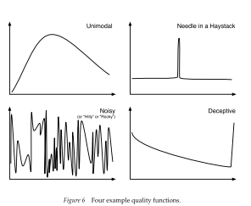
Approximation Optimization Algorithms
Goal: finding a good/better solution (optimal solution cannot be guaranteed!)
(Local) minimum/maximum in solution space
Balancing Exploration and exploitation
Prevents getting stuck in local optima
Combining constructive and iterative algorithms often useful
Good starting point further exploited
Algorithms often tweaked using (meta-) heuristics
Understanding the problem helps

Slide 6
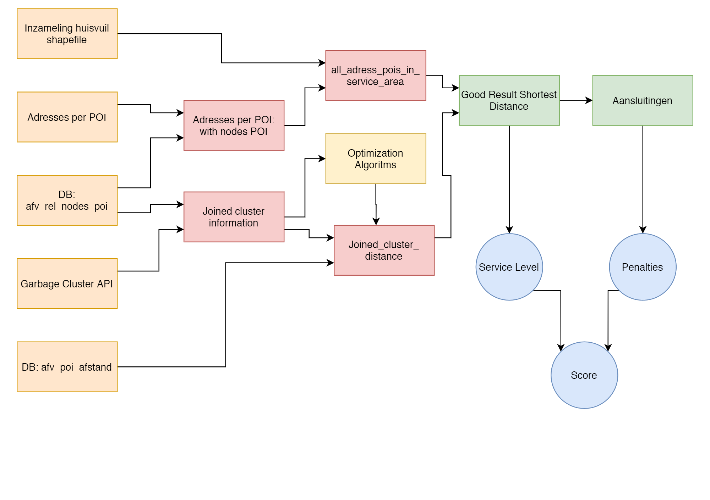
Methodololgy
Data exploration to understand format of data
Goal was to draw interactive map of garbage containers for final depiction of results
Setting up data flow to combine data from different sources into workable format
3 different sources in differnt formats
Calculate score current situation (baseline)
Apply approximation algorithms
Constructive algorithm to provide candidate solutions
Iterative algorithms to improve best candidate(s)
Calculate score repeatedly
Keep track of best configuration and plot process
(Visualize best solution on map of Amsterdam)
(Repeat optimization or manually resolve hotspots)

Slide 7
Notes:
Only households where garbage is to be collected centrally
API data containing configuration of container cluster
DB data rel.poi to get both POI ID’s and coordinates
DB data afstanden to get walking distances from POI to POI
DB Adresses per POI to apply multiplication factor

Slide 8
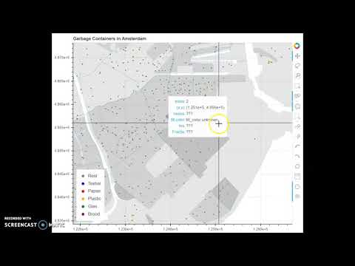
Results
Interactive map of the garbage containers created using Bokeh

Slide 9
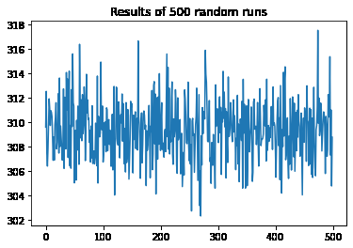
Results
Current solution: Penalty score of 308.19
Random configuration rarely perform better
Baseline in this image was 304 (little errors…)
Combination of random start hillclimber useful
Long computation times to perform sufficient amount of iterations (+/- 40s/iteration)

Slide 10
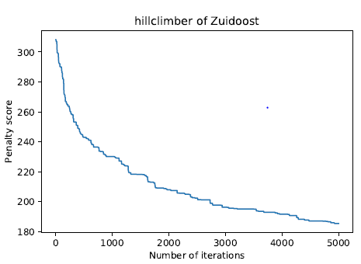
Results
Subcluster analysis reduced computational time and increased improvements
Combination of subclusters to receive good solution

Slide 11
Future work
Linking optimal solution to visualisation mechanism
Improve in poor performing areas / advise on improvements
Improvements in mutation strategies / iterative algorithms
Applying problem-specific heuristics to gain improvement in outcomes
(Creating tool to help in decision making)
(Variable score function)

